Slide 1


CAPSTONE PROJECT REPORT
CSA1718 Artificial Intelligence for Large Language Model
ROAD SAFETY ANALYSIS IN UK
Submitted by,
M. Manikanda prabhu (192224230)
S. Vijay (192224183)
S. Manishankar(192224196)
(Dept. of AI&DS)
Guided by,
Dr. S. Senthil vadivu
Associate professor
Data Vista,
(Dept. of computer science engineering)

Slide 2
TABLE OF CONTENTS
1) Introduction 5) AlgoRithm
2) Abstract 6) PREREQUISITES
3) Literature 7) FUTURE SCOPE
4) Gap analysis 8) CONCLUSION

Slide 3

INTRODUCTION
Welcome to the road safety analysis in the UK. In this presentation, we will delve into the key findings and insights regarding road safety in the UK. From examining traffic trends to outlining safety recommendations, we aim to provide a comprehensive overview of the current scenario.

Slide 4
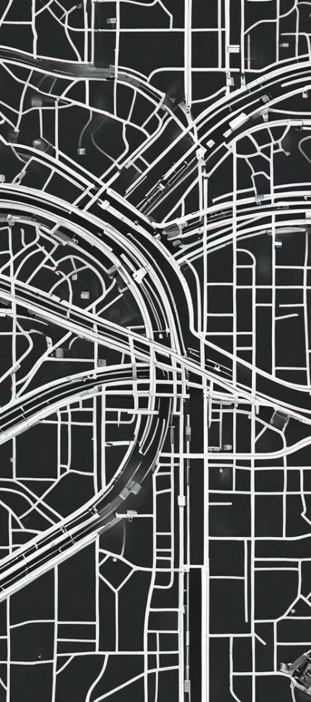
ABSTRACT
Research Topic
Data Collection
An analysis of road safety in the UK, focusing on current challenges and potential solutions.
Review of accident data, traffic patterns, and driver behavior to identify trends and risk factors.
Policy Implications
Assessment of existing road safety policies and recommendations for improvement based on findings.

Slide 5
LITERATURE SURVEY
Historical Analysis: Review of past research on road safety in the UK.
Traffic Management: Study on effective traffic control measures and their impact.
Driver Behavior: Analysis of psychological factors influencing driver decision-making.

Slide 6

GAP ANALYSIS
1
Evaluation of Current Road Safety Measures
Analyzing the effectiveness of existing road safety protocols and initiatives.
2
Identification of Key Gaps
Pinpointing areas where the current safety measures fall short or are inadequate.
3
Recommendations for Improvement
Proposing strategies and interventions to address the identified gaps and enhance road safety.

Slide 7
ALGORITHMS
Machine Learning Algorithms
Graph Algorithms
Sorting Algorithms
These algorithms are used to solve problems related to graphs and networks.
These algorithms rearrange items in a specific order based on a comparison operator. They are used for sorting data efficiently.
These algorithms use historical data to make predictions and decisions. They are trained using large datasets.
They are particularly useful in areas like transportation networks, social network analysis, and computer networks.
They are commonly used in areas like recommendation systems, fraud detection, and natural language processing.
Common sorting algorithms include merge sort, quicksort, and bubble sort.

Slide 8
PREREQUISITES
Road safety analysis in the UK requires a strong foundation in statistical analysis and data interpretation. Familiarity with traffic flow models, risk assessment methodologies, and geographic information systems (GIS) is essential. Understanding of traffic laws, regulations, and public policy is also crucial for comprehensive analysis.
Proficiency in data visualization tools and software, along with knowledge of relevant research in the field, is necessary. The ability to interpret complex datasets and identify patterns is vital to effectively assess road safety measures and potential interventions.
Furthermore, a multidisciplinary approach, incorporating elements of engineering, psychology, and public health, is beneficial for a holistic understanding of road safety dynamics. Collaboration with government agencies, academic institutions, and transportation stakeholders is key to obtaining relevant data and insights.
Query for image: Detailed aerial view depicting traffic flow patterns in urban and rural settings, illustrating the complexity of road networks and the interconnected nature of transportation systems. Vibrant, clear lighting to emphasize geographic features and traffic density, highlighting the need for comprehensive safety analysis.

Slide 9



FUTURE SCOPE
Innovation
Collaboration
Progress
New technological advancements and creative solutions to enhance road safety measures.
Cross-sector partnerships and joint initiatives to address road safety challenges.
Continuous improvement and advancements in road safety systems and protocols.

Slide 10
CONCLUSION
Positive Trends in Road Safety
Impact of Technology
The analysis revealed encouraging improvements in road safety measures and a decline in traffic-related incidents.
Advancements in vehicle safety systems and real-time monitoring have significantly contributed to reducing accidents.
Community Engagement
Recommendations for Further Improvement
Collaborative efforts with local communities have played a pivotal role in promoting road safety awareness and responsible driving habits.
Future initiatives should focus on enhancing infrastructure, enhancing driver education, and implementing stricter traffic regulations.

Slide 11


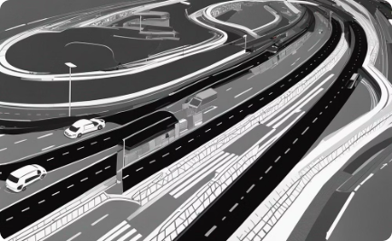
Urban Traffic
Modern Safety Solutions
Data-Driven Analysis
An intricately designed road intersection with bustling traffic and vibrant evening colors, showcasing the dynamics of urban road systems.
An innovative car safety technology with a sleek design, set against a modern urban backdrop, emphasizing the evolution of safety measures.
Visualization of diverse road safety data in a professional setting, highlighting the importance of data-driven analysis for safety improvements.

Slide 12



Road Safety Education
1
Interactive programs for school children
Driver Training
2
Enhanced learning for safe driving practices
Community Engagement
3
Collaborative efforts for promoting road safety

